Slide 1
TreeDB
For all your animal and soil friendly trees!

Slide 2
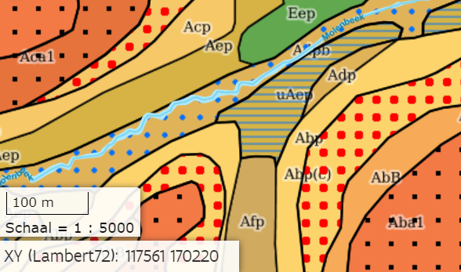
What and Why?
To help people save the planet in a healthy and safe way!
DATA SOURCES
bobo.inbo.be
loc.geopunt.be
pydov
Bolt’s Biotoop

Slide 3
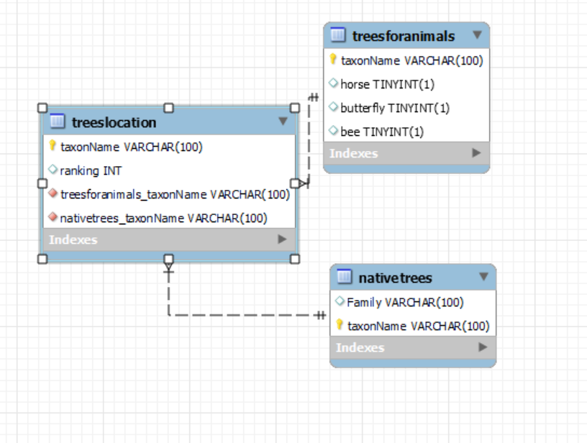
How?
3 Tables
treesLocation
treesForAnimals
nativeTrees

Slide 4
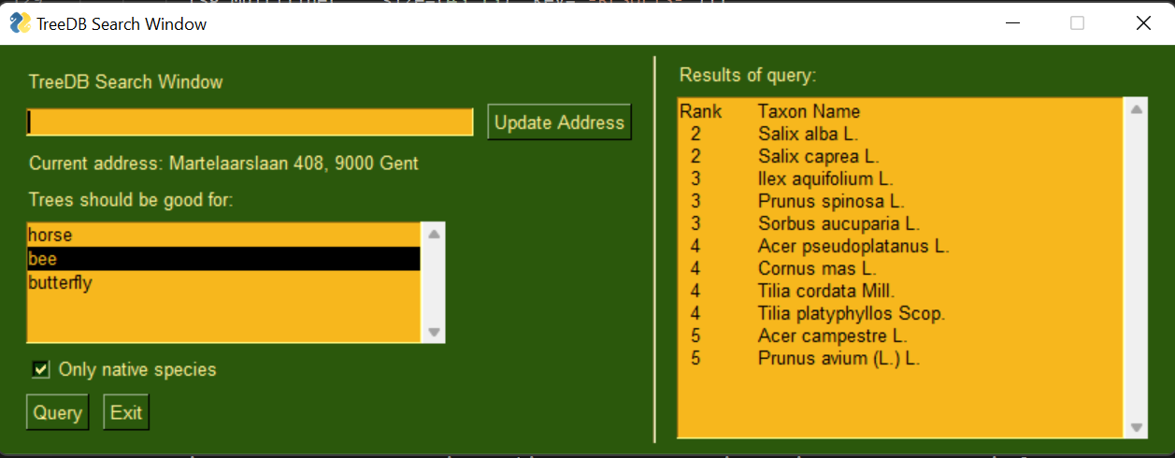
Example

Slide 5
Example
Query: SELECT treesLocation.taxonName, treesLocation.ranking FROM treesLocation,nativeTrees,treesForAnimals WHERE treesLocation.taxonName = nativeTrees.taxonName AND treesLocation.taxonName = treesForAnimals.taxonName AND treesForAnimals.bee = 1 ORDER BY treesLocation.ranking, treesLocation.taxonName

